Slide 1
IoT Capstone Project: Mailbox Delivery Notification
Derek Johnson
University of St. Thomas
SEIS 744

Slide 2
Market Condition
HIGH DEMAND FOR MULTIFAMILY LIVING
“The National Association of Realtors estimates that first-time buyers accounted for only 33% of total homebuyers in 2014, a 27-year low. It’s probably no coincidence that the increase in single-person households has corresponded with the ongoing reduction in homeownership as a percentage of total households, which fell to 64.3% in the third quarter of 2014, according to the Commerce Department. Meanwhile, the rental apartment vacancy rate that quarter stood at 7.4%, the lowest it’s been since Q1/1995.”
”Industry sources continue to point to economic, demographic, and cultural factors that they believe will energize multifamily demand for several years. Marcus and Millichap’s Seebee notes that total housing starts still lag total household formations by about 200,000 annually.”
BATTLING IT OUT IN THE AMENITIES ARMS RACE
“But tenant demand for more and better amenities has launched an arms race among property owners. Dry cleaning services, lofts with office space, and private elevators are only some of the more esoteric amenities finding their way into multifamily dwellings.”
GIVING TENANTS MORE CONTROL OVER TECHNOLOGY
“The industry is slowly moving toward giving tenants greater command over their environments—from entry doors to HVAC systems. The giant builder/developer Forest City has installed cloud-connected devices in apartment projects in Dallas and Washington, D.C. These devices allow tenants to monitor and regulate their lighting, heating, and cooling, says Mike Smith, Forest City’s VP of Technology Service”
“Last June, Parcel Pending, an Irvine, Calif.-based startup, installed its first smart lockers in a test with Shea Properties. When a package is delivered, it is placed in a locker; the tenant is sent a text message and email with a unique six-digit access code to open the locker”
Building Design + Construction: https://www.bdcnetwork.com/5-intriguing-trends-track-multifamily-housing-game

Slide 3
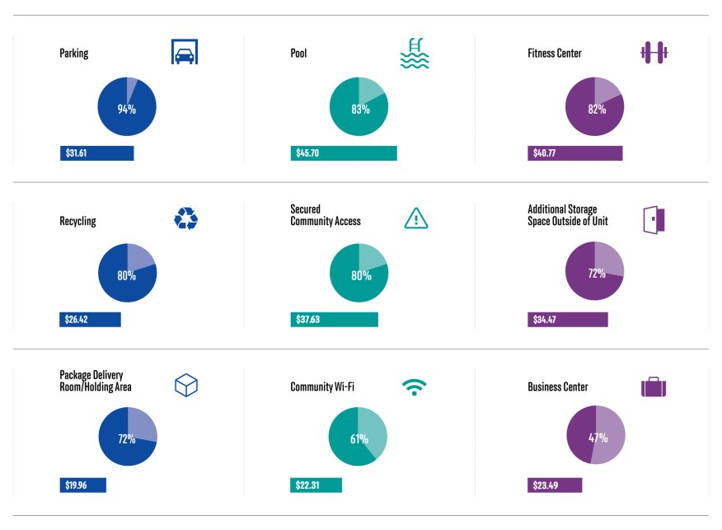
72% of tenants are interested in mail delivery amenities, valuing it at nearly $20 per month
“The National Multifamily Housing Council and Kingsley Associates surveyed approximately 120,000 renters at 3,280 apartment communities nationwide to gauge their interest in specific communal amenities. In the selection of amenities above, the percentages shown represent those residents who said they were “interested” or “very interested” in that amenity; the dollar figures indicate how much more in rent those who were interested or very interested would expect to pay for that amenity.”
http://www.multifamilyexecutive.com/property-management/apartment-trends/amenity-evolution_o

Slide 4
Operational Overview
Reed switch indicates when the circuit has been broken, meaning the mailbox door opened
LED provides visual feedback that the mailbox door is open (and that you’ve reached a part of the code you expected to reach when the door opened)
Photon published to MQTT with the door status (OPEN or CLOSED)
Head Unit subscribes to MQTT to receive door status
Writes status out to log file
Head unit code sends to Twilio the list of cell numbers to send an SMS along with the message to be sent
Head unit code sends to Google Home a message that the mail has arrived

Slide 5
Design Considerations & Future Features
Mailbox Device
Currently wall powered since the only limitation is the length of wire to the reed switch
Based on wired home security system designs, this wire length limitation would be negligible in a mail room setting
Future plans could incorporate battery powered design
Based on wireless home security system designs for door and window sensors, a 9 volt battery with a control board that sleeps until the reed switch changes state would last 9-12 months
Future design would incorporate indicating if any mail itself was in an individual mailbox
Originally thought the per mailbox cost might be too high for all the additional sensors, but if tenants value a smart mailroom at $20 per month, this may be more feasible

Slide 6
Design Considerations & Future Features
Head unit/Control unit
Currently utilizing text based feedback from the shell on a local computer
Future design would implement in the cloud
Currently using a public MQTT broker
Future design would utilize private MQTT broker to enhance security
Currently using a free Twilio account to send SMS messages
Limits to sending text to your own phone only
Future design would utilize either a paid Twilio account in order to send SMS to multiple phones – or – implement proprietary code to handle this
Additional features:
Allow setting WiFi network and password for the mailbox device
Provide battery life indicator
Provide mailbox on-line status

Slide 7
Design Considerations & Future Features
End user
Currently receives text notification that the mail has been delivered
Future design would incorporate non-screen notification methods
Google Assistant, Amazon Alexa, Apple Siri integration
Informed Delivery by USPS, UPS My Choice, and FedEx Delivery Manager integration

Slide 8
